Slide 1

CSE 591 Text and Document Visualization
Ross Maciejewski
rmacieje@asu.edu

Slide 2
Text is Everywhere
We use documents as the primary information artifact in our lives.
Our access to documents has grown tremendously in recent years due to networking infrastructure.
WWW
Digital Libraries
Electronic Books
Etc.

Slide 3
Big Question
What can information visualization provide to help users in understanding and gathering information from text and document collections?

Slide 4
Challenge
Text is nominal data
Does not seem to map to geometric/graphical presentation as easily as ordinal and quantitative data.
The “Raw Data --> Data Table” mapping now becomes more important.

Slide 5
Information Retrieval vs. Visualization
Information Retrieval is an active search process that returns specific items.
Visualization is more useful when the searcher isn’t sure precisely what they’re looking for.
More of a browsing task than a searching one.

Slide 6
Visualization in Information Retrieval
Can visualization help Information Retrieval?
Given some active search or query, we can:
Show results visually.
Show how query terms relate to results.
Others?
Notes:
Query forward and backward

Slide 7
Visualization-Enhanced Search Engine
Creating a visual search engine was a ‘holy grail’ for a while.
Has not worked very well so far.

Slide 8
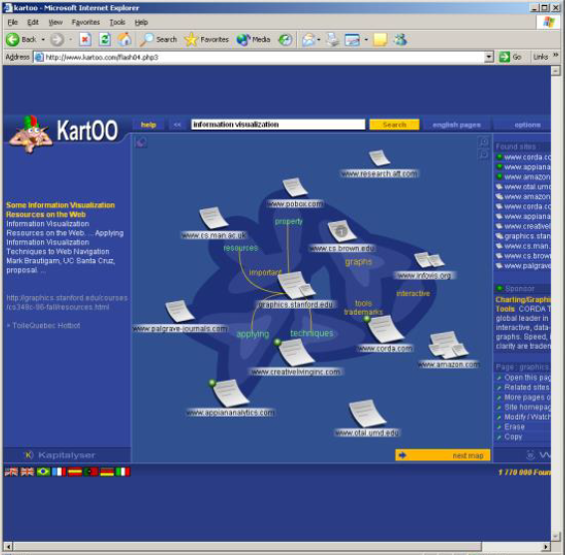
Search Visualization
http://www.kartoo.com (Now Defunct)

Slide 9
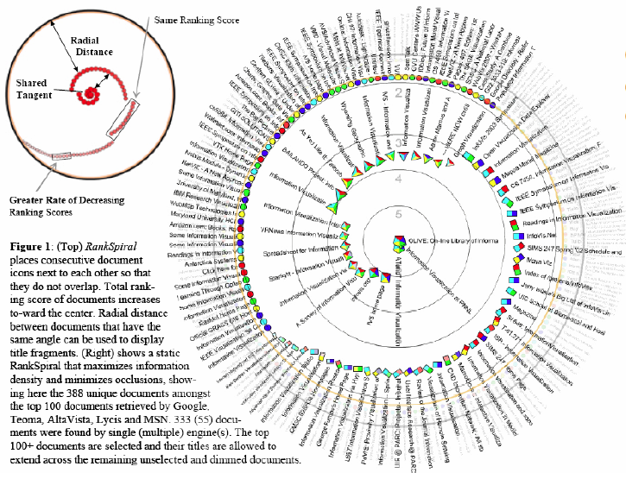
RankSpiral
From Spoerri’s InfoVis 2004 Poster

Slide 10
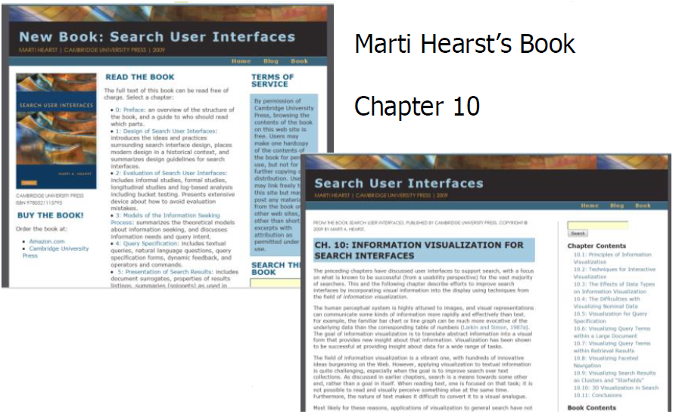
More Information
http://searchuserinferfaces.com/book/

Slide 11
Representing Text
How do we represent the words, phrases, and sentences in a document or set of documents?
Search vs. understanding

Slide 12
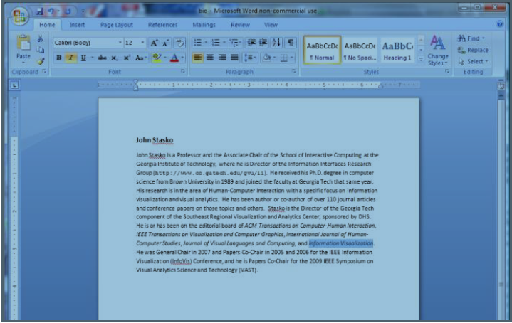
One Way to Represent Text
Uses:
Layout
Font
Style
Color

Slide 13
Design Challenge
How would you visualize one of the presidential debates?

Slide 14
Tasks
What kind of questions or tasks would someone want to do with such a visualization?

Slide 15
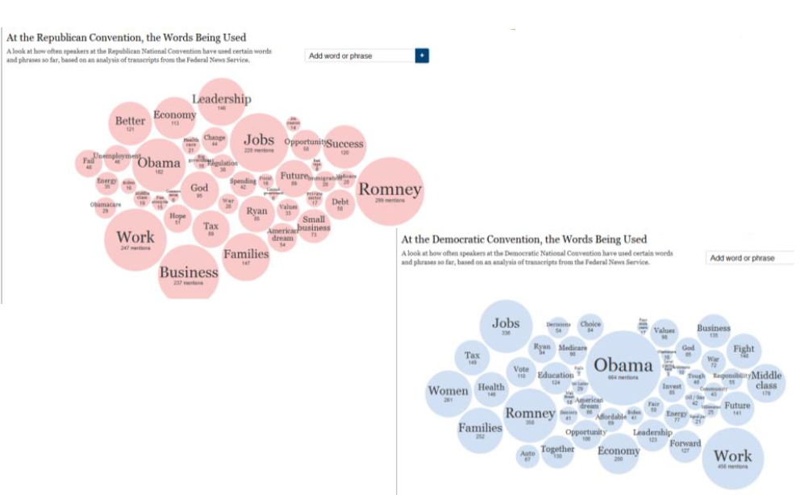
Word Counts
http://www.nytimes.com/interactive/2012/08/28/us/politics/convention-word-counts.html

Slide 16
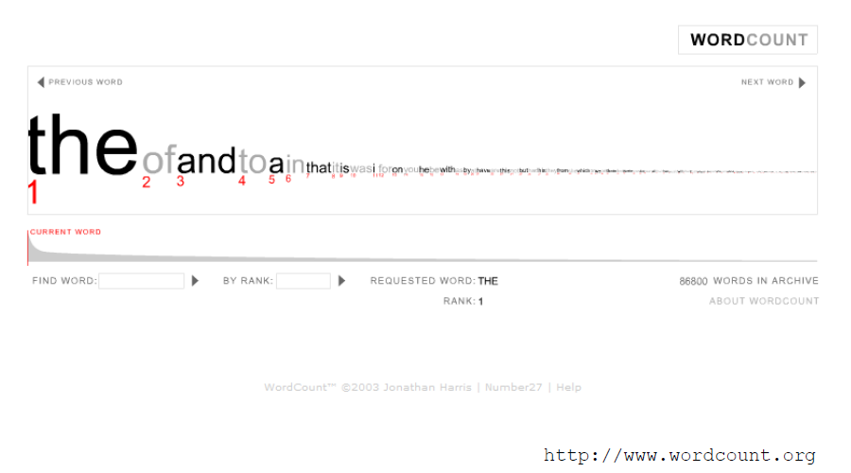
More Word Counting

Slide 17
Tag/Word Clouds
Currently very popular in the research community.
Have proven to be popular on the web.
Idea is to show word/concept importance visually.
Tags: User-specified metadata (descriptors) about other objects.
Sometimes generalized to just reflect word frequencies.
Notes:
trivial words like and/the/or are ignored

Slide 18
History
90-year old Soviet Constructivism
Milgram’s ‘76 experiment to have people label landmarks in Paris.
Flanagan’s ‘97 “Search referral Zeitgeist”
Fortune’s ‘01 ‘Money Makes the World Go Round’

Slide 19
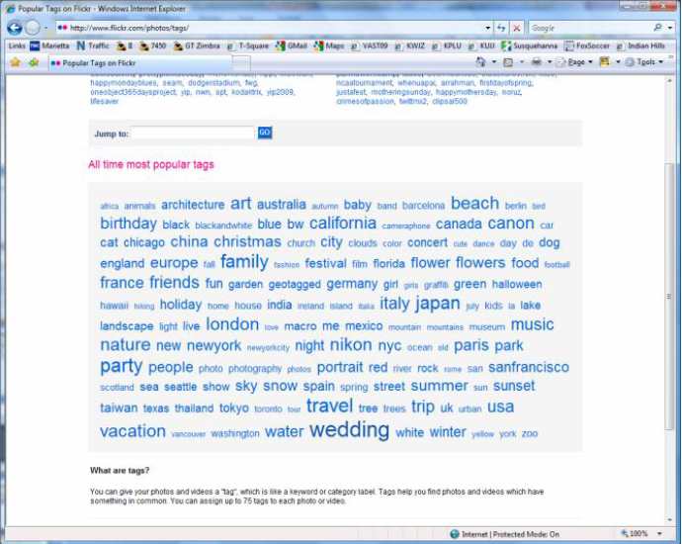
Flickr Tag Cloud

Slide 20
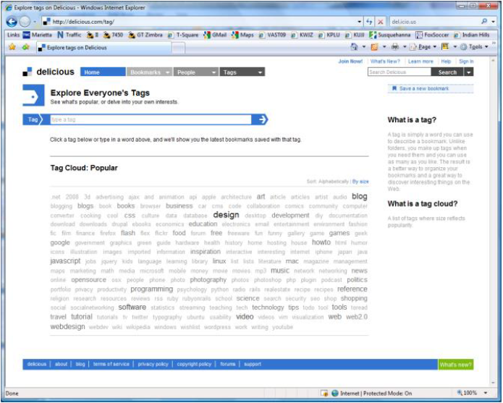
delicious Tag Cloud

Slide 21
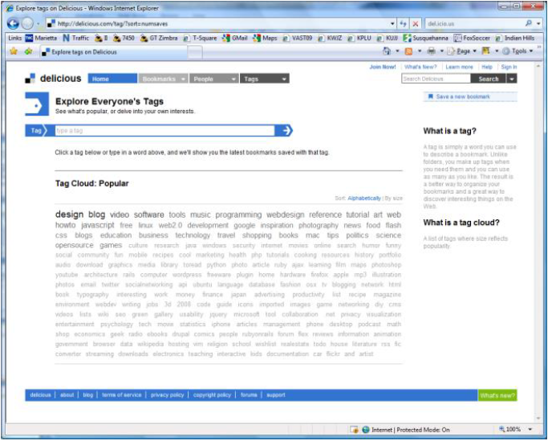
Alternate Order

Slide 22
Amazon’s (old) Product Concordance

Slide 23
More Information
There are other
types of info
about a document
on Amazon

Slide 24
Many Eyes Tag Cloud
Here, pairs
of words are
shown.

Slide 25
Problems
Actually not a great visualization.
Hard to find a particular word.
Long words have increased visual emphasis.
Font sizes are hard of compare.
Alphabetical ordering not idea for many tasks.
Studies have shown that they underperform.¹
¹Gruen et. al., CHI 2006
Notes:
- infrequent words are hard to search in a tag cloud
- some words could have never been said

Slide 26
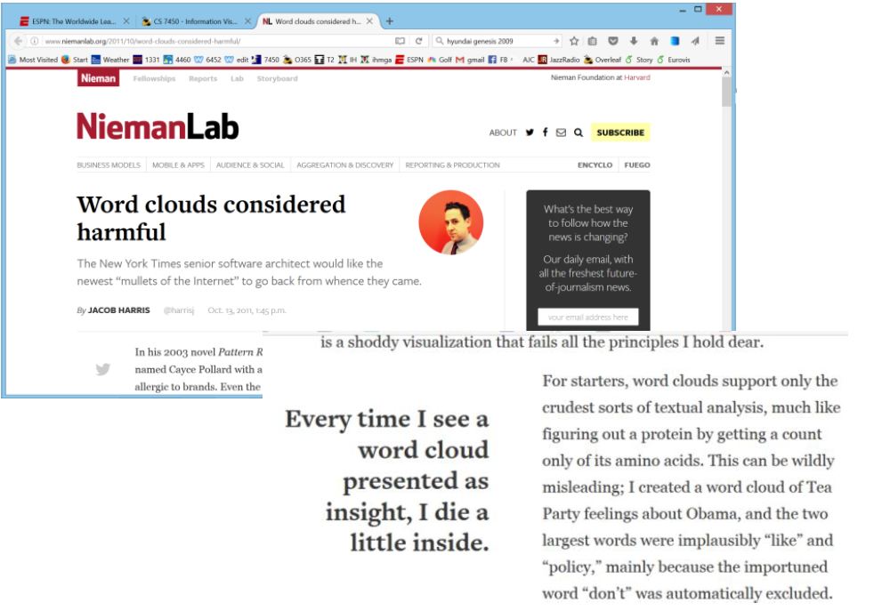
http://www.niemanlab.org/2011/10/word-clouds-considered-harmful/

Slide 27
Why So Popular?
Serve as social signifiers that provide a friendly atmosphere that provide a point of entry into a complex site.
Act as individual and group mirrors
Fun, not business-like

Slide 28
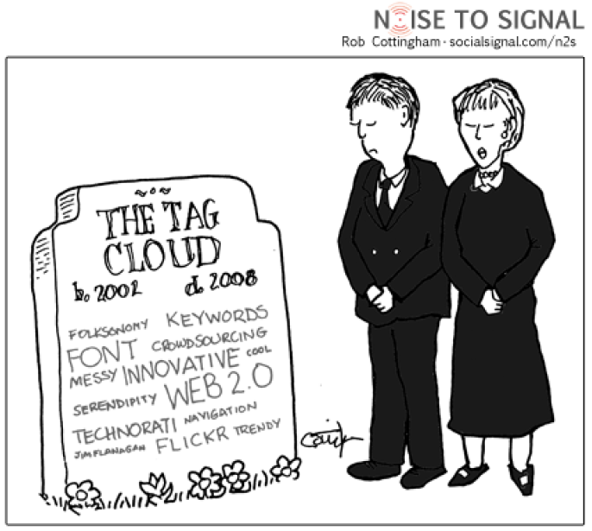
http://www.socialsignal.com/system/files/images/2008-08-01-tagcloud.gif

Slide 29
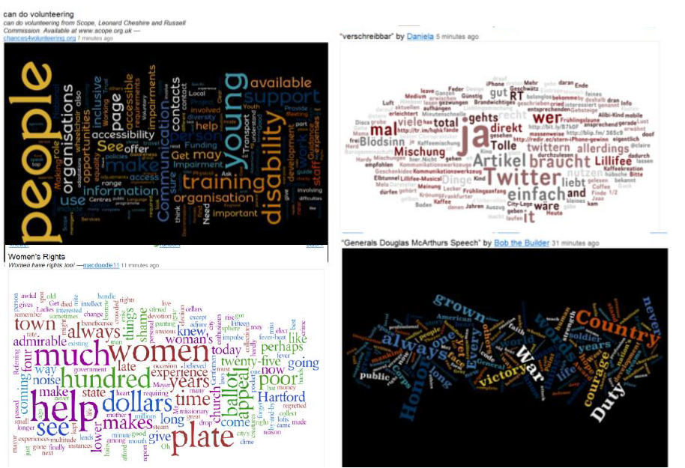
Wordle
http://www.wordle.net

Slide 30
Wordle
Tightly packed words, sometimes vertical or diagonal
Word size is linearly correlated with frequency
Typically square root in cloud
Multiple color palettes
User gets some control
Viegas, Watternberg, and Feinberg, TVCG (InfoVis), 2009

Slide 31
Layout Algorithm
Details not published
Idea:
Sort words by weight, decreasing order
for each word w
W.position := makeInitialPosition(w)
While w intersects other words:
updatePosition(w)
Initial position randomly chosen according to distribution for target shape.
Update position moves out radially.

Slide 32
Fun Uses
Political speeches
Songs and poems
Love letters
Wedding vows
Cours syllabi
Teaching writing
Gifts

Slide 33
2-Day Survey in Jan. 09
2/3 of respondents were women
Interest came from design, visual appeal, beauty
Why preferred over word clouds:
Emotion impact
Attention-keeping visuals
Organic, non-linear
Fair percentage didn’t know what size signified

Slide 34
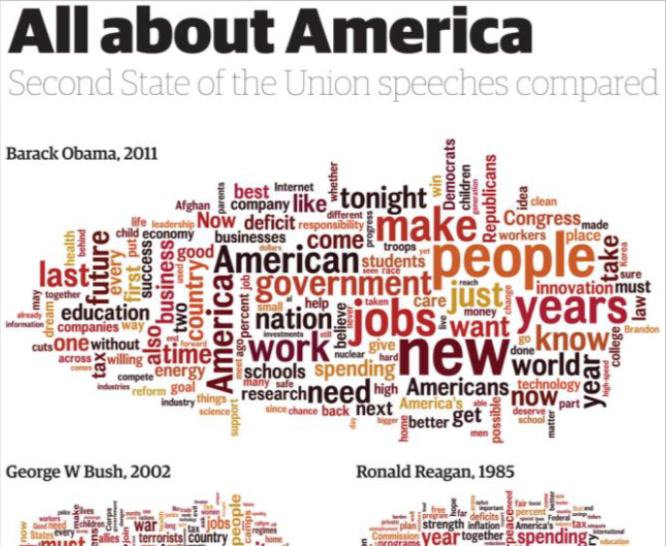
State of the Union Wordles
http://www.guardian.co.uk/news/datablog/2011/jan/25/state-of-the-union-text-obama#

Slide 35
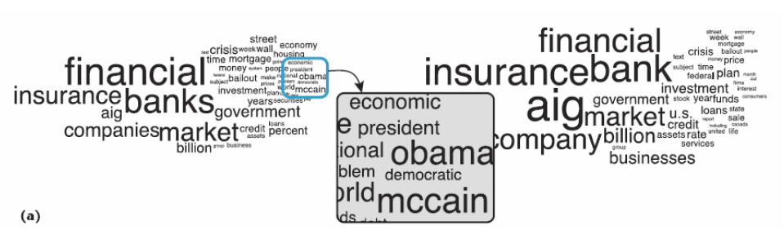
A Little More Order
Order the words more by frequency
Cui et. al., IEEE CG&A, 2010

Slide 36
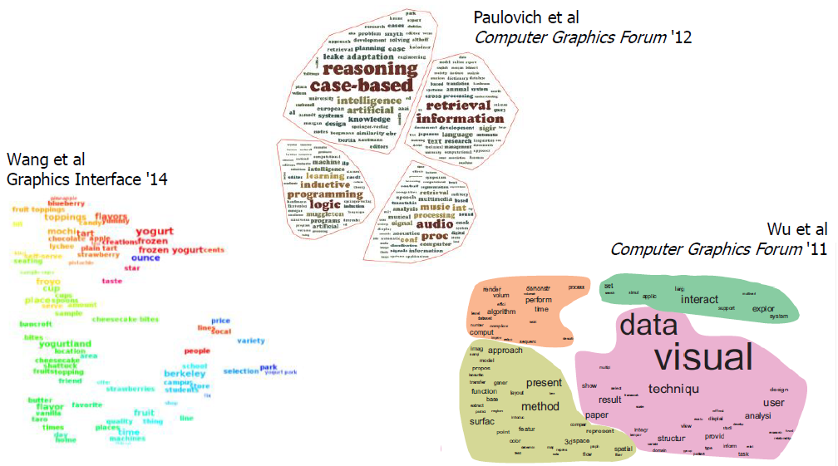
Semantic/Context Word Clouds

Slide 37
Wordle Characteristics
Layout, words are automatic
If you had some control, what would you like to change or alter?

Slide 38
Mani-Wordle
Start with nice default algorithm
Give user more control over design
Alter color (within a palette)
Pin words, redo the rest
Move and rotate words
Smooth animation and collision detection for tracking changes

Slide 39
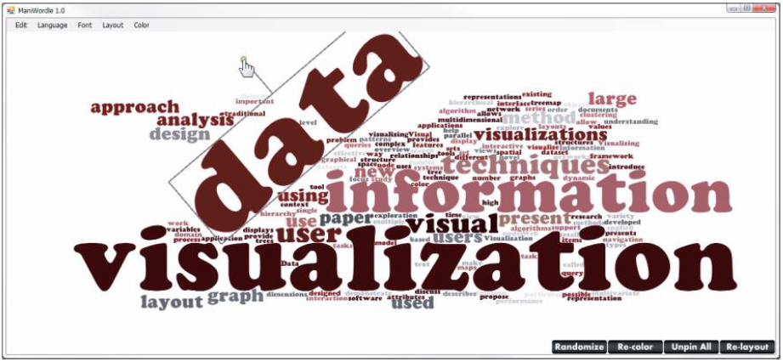
Video

Slide 40
Text Analysis on the Web
http://voyant-tools.org/

Slide 41
Multiple Documents
How to show word frequencies across multiple related doucments?

Slide 42
Parallel Tag Clouds
Different Circuit Courts
Collins et al, VAST 2009

Slide 43
Analytic Support
Note: Word Clouds and Wordles are really more overview-style visualizations
Don’t really support queries, searches, drill-down
How might we also support queries and search?

Slide 44
Overview and Timeline
State of the Union
Addresses
http://www.nytimes.com/ref/Washington/20070123_STATEOFUNION.html?initialWord=iraq

Slide 45
FeatureLens
Show patterns of words or
n-grams.
http://www.cs.umd.edu/hcil/textvis/featurelens/
Don et al, CIKM 2007

Slide 46
SeeSoft Display
Like taping text to the wall and walking far away
Eick, Journal of Computational & Graphical Statistics, 1994

Slide 47
Beyond Individual Words
The previous techniques focus largely on words
Especially word clouds and wordless
Can we show combinations of words, like actual phrases and sentences, in order to provide more context?

Slide 48
Concordance
Definition

Slide 49
Concordance in Text
http://www.concordancesoftware.co.uk

Slide 50
Word Tree
From King James Bible
Notes:
Shows phrases of interest

Slide 51
Word Tree
Shows context of a word or words
Follow word with all the phrases that follow it
Font size shows frequency of appearance
Continue branch until hitting unique phrase
Clicking on phrase makes it the focus
Ordered alphabetically, by frequency, or by first appearance
Wattenberg and Viégas, TVCG (InfoVis), 2008

Slide 52
Interaction

Slide 53
Many Eyes’ WordTree

Slide 54
Phrase Nets
Examine unstructured documents
Presents pairs of terms and phrases such as
X and Y
X’s Y
X at Y
X (is|are|was|were) Y
Uses special graph layout algorithm with compression and simplification
van Ham et al, TVCG (InfoVis), 2009

Slide 55
Examples

Slide 56
Examples, cont.

Slide 57
User Interface

Slide 58
Words and Context
Can we show most frequent words like a word cloud but also provide context?
Should each word appear one time?
But then how to show context?
If appears multiple times, how to make that work?

Slide 59
SentenTree
Elements of word clouds and word trees
Highlight keywords using size
Show sentence fragments
Provide a summary of the dataset
Enable drill-down into details

Slide 60
Example
Summary of 189,450 tweets (108,702 unique) posted in a 15 minute time window around the first goal of the opening game of the 2014 Soccer World Cup
Interaction is key & not shown here

Slide 61
Example, cont.
Tweets mentioning word “Yosemite” from Aug 1, 2014

Slide 62
Video

Slide 63
Another Challenge
Visualize an entire book
What does that mean?
Word appearances
Sentences

Slide 64
TextArc
Sentences laid out in order of appearance
Words near to where they appear
Significant interaction
Brad Paley

Slide 65
Next Time
More about collections of documents and showing other characteristics of documents
Analysis metrics
Entities
Concepts & themes

Slide 66
Reading
Viegas & Wattenberg, 2008

